Slide 1

Arizona State Retirement System
Investment Committee
New Trustee Orientation
June 2017

Slide 2
Fixed Income
We have an overweight allocation to Fixed Income with a weighting as of May 31, 2017 of 26.6% vs. the interim SAA target of 25.0%. Following the US presidential election, we lowered our allocation to Fixed Income by cutting back our holdings of Interest Rate Sensitive Fixed Income assets.
The overweight in Fixed Income reflects an overweight in Opportunistic Debt (3.8% vs. a 0.0% target) and an overweight in High Yield Fixed Income (2.7% vs. a 2.4% target) offset by an underweight in Interest Rate Sensitive Fixed Income (10.8% vs. a 13.3% target).
We continue to believe that the Private Debt asset class offers the most attractive opportunity in fixed income with double-digit yields and relatively stable investment performance available for investors willing to accept illiquidity. We have recently expanded our commitments to this asset class.
Effective April 1, 2017, the SAAP target for Private Debt was raised to 12% from 10% with a permissible range of 8-16%. As of May 31, 2017, investments in Private Debt represented approximately 9.3% of the total fund while our partnership commitments represented approximately 14.3% of the total fund. While the SAAP target for Private Debt was raised, it was lowered for High Yield Fixed Income to 2% of the total fund (with a range of 0-6%) from 4%.

Slide 3
Fixed Income Positioning vs. SAAP
As a May 31, 2017, ASRS was positioned in Fixed Income as follows versus the SAAP adopted in 2015 (as further revised effective April 1, 2017) and the Interim Adjusted SAAP Policy targets:
Interim
SAAP Adjust. Over/
Actual Target SAAP (Under)¹
Total Fixed Income 26.6% 25.0% 25.0% 1.6%
Interest Rate Sensitive 10.8% 11.0% 13.3% (2.5%)
High Yield 2.7% 2.0% 2.4% 0.3%
Private Debt 9.3% 12.0% 9.3% 0.0%
Opportunistic Debt 3.8% 0.0% 0.0% 3.8%
¹ Versus Interim SAA adjusted policy with unfunded Private Debt prorated to Interest Rate Sensitive and High Yield.
3

Slide 4
Interest Rate Sensitive Fixed Income

Slide 5
Interest Rate Sensitive Fixed Income
Interest Rate Sensitive Fixed Income is comprised of the Core Fixed Income and Treasuries (Long Duration) asset classes. Core fixed income represents the US investment-grade market which includes US Treasuries and Agencies, Agency Mortgage-Backed Securities, Corporate Bonds, Commercial Mortgage-Backed Securities (CMBS) and Asset-Backed Securities (ABS). Its benchmark is the Barclays U.S. Aggregate Bond Index, which encompasses the market for U.S. dollar denominated, fixed-rate, taxable, investment-grade bonds that are SEC-registered. Treasuries (Long Duration) is comprised of US Treasuries with maturities of 10 years or longer; its benchmark is the Barclays U.S. Treasury Long Index.
The performance of Interest Rate Sensitive Fixed Income is heavily tied to the direction of US Treasury rates. In addition, Interest Rate Sensitive Fixed Income tends to perform well when equity markets decline (ex. 2008) or when inflation expectations materially decline. As a result, it is an important part of the overall ASRS portfolio because it provides a source of balance and diversification from riskier assets such as equities.
IMD House View:
Interest Rate Sensitive Fixed Income is likely to generate low returns as Treasury rates, corporate credit spreads and agency MBS spreads are at low levels. As a consequence, we are underweight Interest Rate Sensitive Fixed Income vs. the interim SAA adjusted policy target. We are also concerned that interest rates may rise over the intermediate term as global growth and inflation expectations are generally improving and central banks such as the Federal Reserve and the ECB are likely to pull back from monetary policies that have pushed down rates in major developed countries.
Weighting vs. Revised Interim SAAP Policy Effective 4/1/17: Underweight
ASRS Actual Weighting (May 31, 2017) 10.8%
Pro Forma Interest Rate Sensitive Interim Adj. Policy 13.3%

Slide 6
Core Fixed Income Managers
Portfolio | Market Value ($MM) 5/31/17 | % | IMD Commentary
Blackrock US Debt Index Fund | $2,025 | 50 | Passive strategy with history of modest outperformance.
F2 Internally Managed Account | $1,911 | 47 | Enhanced passive strategy with an objective to slightly outperform the Barclays U.S. Aggregate Bond Index (the “Index”) through a stratified sampling strategy. History of outperformance particularly over the past 10-year period.
Assetized Cash | 100 | 3 | Assetized cash held in US Treasuries.
Total | $4,036 | 100

Slide 7
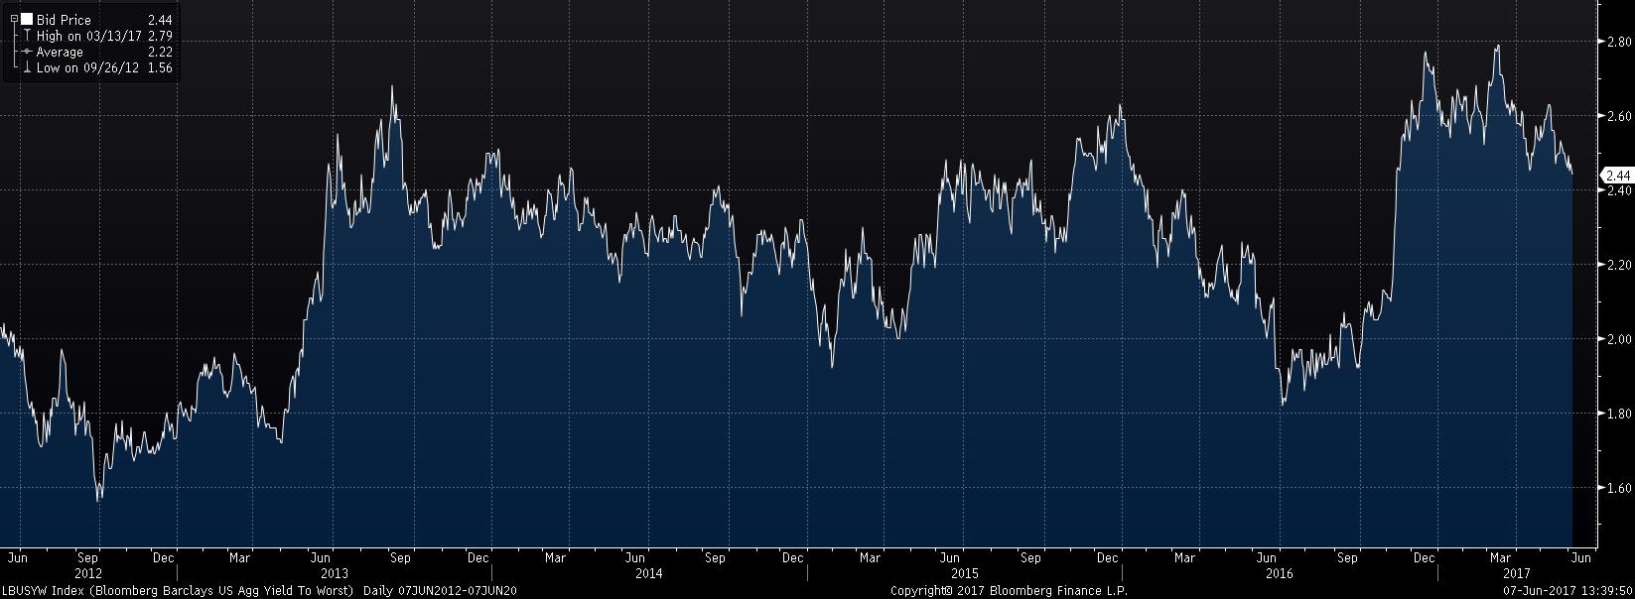
Barclays U.S. Aggregate Yield-to-Worst 2012 – 2017

Slide 8
Treasuries (Long Duration) Manager
Portfolio | Market Value ($MM) 5/31/17 | % | IMD Commentary
BlackRock Long Term Government Bond Index Fund | $ 0 | 100 | Passive strategy. We currently do not have an allocation to the Treasuries (Long Duration) asset class.
Total | $0 | 100

Slide 9
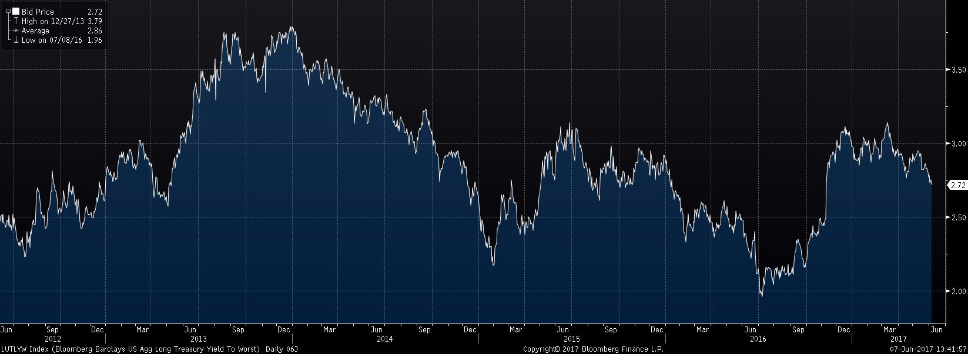
Barclays U.S. Long Treasury Index Yield 2012 – 2017

Slide 10
High Yield Fixed Income

Slide 11
High Yield Fixed Income
High Yield Fixed Income is the below investment-grade corporate bond market in the US. Unlike Interest Rate Sensitive Fixed Income which has a high correlation with Treasury rates, High Yield Fixed Income has historically had a negative correlation with Treasury rates and a positive correlation with the equity markets.
Returns are heavily influenced by credit developments at highly leveraged companies whose performance is tied to factors that affect equity markets (economic outlook, earnings, cash flow, valuations, etc.)
IMD House View:
With the revised Interim SAAP effective 4/1/17 in which the target for High Yield Fixed Income was cut to 2% from 4%, we have a modest overweight in High Yield Fixed Income. The U.S. high yield market has had an unusually long credit cycle, which began with an upturn in 2009. With an improved business outlook and strong global demand for yield buoying the high yield market, we believe that defaults will likely remain low for the foreseeable future and the credit cycle will remain elongated. High Yield Fixed Income will likely outperform Interest rate Sensitive Fixed Income in the near-term. That being said, we have been reducing our weighting in High Yield Fixed Income to fund the expansion of our investments in Private Debt, an asset class which offers significantly higher expected returns with lower volatility.
Weighting vs. Revised Interim SAAP Effective 4/1/17: Overweight
ASRS Actual Weighting (May 31, 2017) 2.7%
Pro Forma High Yield Fixed Income Interim Adj. Policy 2.4% (0-6% range)

Slide 12
High Yield Fixed Income Managers
Portfolio | Market Value ($MM) 5/31/17 | % | IMD Commentary
Columbia Separate Account | $639 | 62 | Active manager with flexible investment style that adjusts portfolio risk based on the investment outlook. While Columbia has meaningfully underperformed the high yield benchmark for the one-year period, it has significantly outperformed over the most recent three-year period and has a longer term track record well above its peers.
JP Morgan High Yield | $385 | 38 | Active manager with a flexible investment style that is agnostic to credit quality. Since the inception of the mandate in 2013, JP Morgan has slightly underperformed the high yield benchmark. Its track record for the one- and three-year periods compares favorably with its peers.
Total | $1,024 | 100

Slide 13
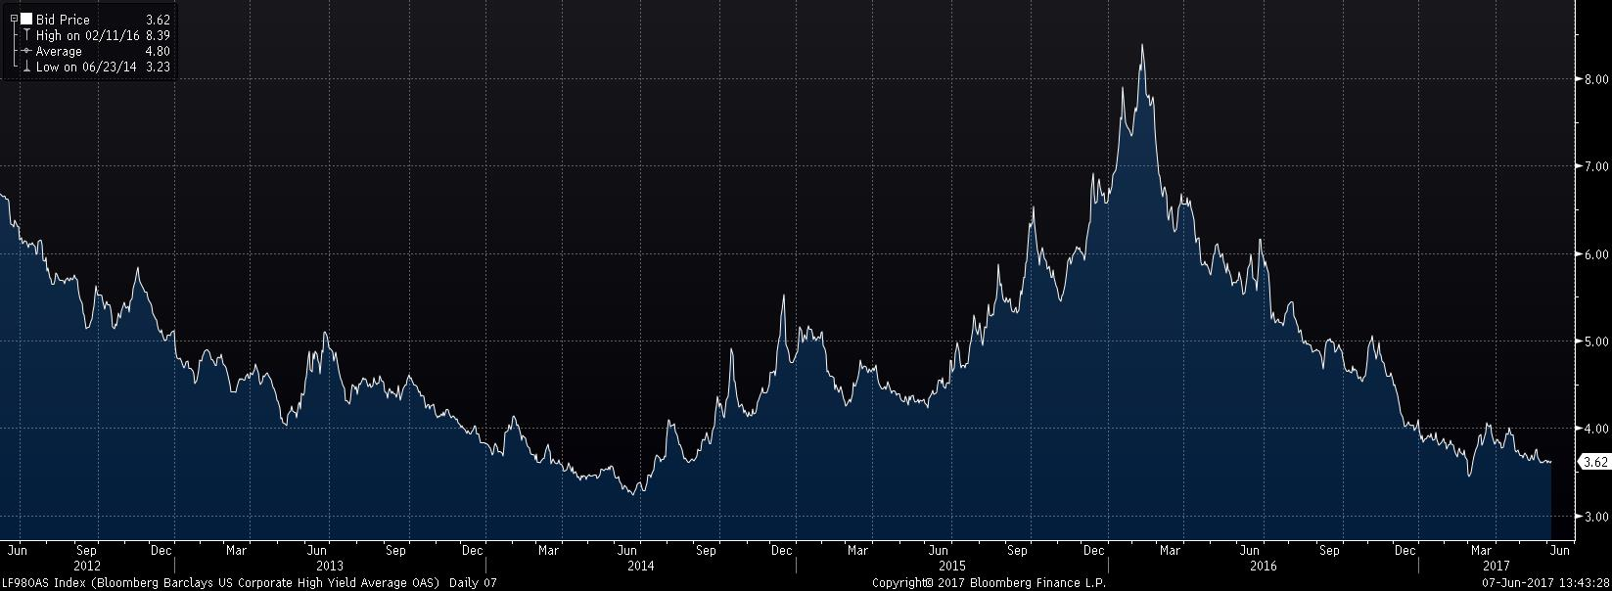
Barclays US Corporate High Yield Index Option Adjusted Spread (OAS) 2012 – 2017

Slide 14
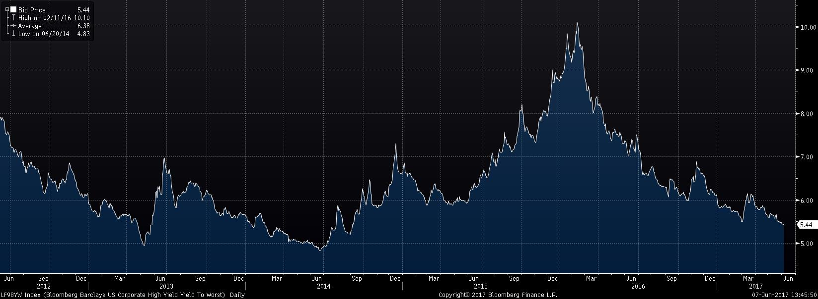
Barclays US Corporate High Yield Index Yield-to-Worst 2012 – 2017

Slide 15
Private Debt

Slide 16
Private Debt
Private Debt is comprised of illiquid loans and bonds that typically fund highly leveraged companies and real estate properties that are typically too small in size to meet the requirements of the tradable leveraged loan, high yield bond, or commercial mortgage-backed securities markets. For example, Private Debt may consist of secured loans funding leveraged buyouts of small to mid-size companies or mezzanine financing for real estate properties.
Returns in the asset class are determined by: 1) the expected returns of individual investments (based on the cash coupon rate or spread over LIBOR and other sources of return including underwriting fees, original issuance discounts and premium call features) and 2) the actual level of credit losses experienced in the underlying portfolios.
IMD House View:
Private Debt offers the most attractive opportunity in the fixed income markets with double-digit yields readily available for investors willing to accept illiquidity. The market opportunity is principally driven by regulatory constraints that make it unattractive for banks to hold illiquid loans or other debt of below investment-grade credit quality. We have recently expanded our commitments to this asset class.
Actual Weighting vs. Revised SAAP Policy Effective 4/1/17: Underweight¹
Actual Weighting (May 31, 2017) 9.3%
Private Debt Policy 12.0% (8-16% range)
¹ASRS is tactically overweight based on commitments made of approximately 14.3% of the total fund.

Slide 17
Private Debt Characteristics
Pros
High Expected Net Returns (10-11% on average)
Substantially higher gross returns (a combination of yield, fees, OID, and call premiums) than comparable public market securities (high yield bonds, tradable bank loans, asset-backed securities, CMBS)
Low loss history in underlying portfolios
Primarily Floating Rate
Approximately 80% of ASRS’s ongoing private debt commitments are expected to be floating rate investments
Full Due Diligence by Managers
Customized Covenants and Credit Monitoring
Cons
Illiquid
Delayed Deployment of Capital

Slide 18
Private Debt Market Environment
Demand for corporate loans are driven by: 1) middle market buyout and acquisition activities which need financing, and 2) middle market borrowers which need to refinance existing loans from banks.
Regulatory constraints limit banks ability to make below investment-grade, illiquid loans (typically to middle market companies)
Basel III
Dodd-Frank
“Leveraged Lending Guidelines” of OCC/Fed/FDIC

Slide 19
ASRS Private Debt Program
Lending Strategies Diversified Across 10 Managers
US Corporate
Five managers targeting unique areas of the middle market
One manager targeting larger companies
European Corporate
One manager targeting middle market lending
Real Estate Finance
Two managers targeting three market segments
Asset Backed
One manager targeting unique market opportunity

Slide 20
ASRS Private Debt Program
Focus on Fund-of-One Partnerships With Leading Managers
Customized Terms:
Scalable
Evergreen
Termination Rights
Superior Fees
Investment Restrictions
Leverage Constraints (if applicable)

Slide 21
Private Debt Managers
Portfolio | ASRS Commitment ($MM) | Market Value ($MM) 5/31/17 | Target Net Return | % | IMD Commentary
Sonoran Private Credit Opportunities Fund, LLC (Managed by Cerberus) | $1,100 | 912 | 13% | 26 | Separate account that invests in floating-rate secured loans primarily to fund private-equity sponsored middle market leveraged transactions . The LLC can leverage ASRS’s investment by up to 1.5x to boost returns.
Cactus Direct Lending Fund, LP (Partnership with HPS) | $750 | 383 | 12% | 11 | Fund-of-one partnership that invests in floating-rate secured loans primarily to fund middle market leveraged transactions (ex. buyouts, recapitalizations) often without a private equity sponsor. The partnership can leverage ASRS’s equity investment by up to 1.25x to boost returns.
Monroe Private Credit Fund A | $650 | 384 | 11% | 11 | Fund-of-one partnership that invests in floating-rate secured loans primarily to fund smaller middle market leveraged transactions . The partnership can leverage ASRS’s equity investment by up to 1.25x to boost returns.
RFM Cactus Holding Company, LLC (Partnership with Related) | $625 | 461 | 10% | 13 | Fund-of-one partnership that invests in: 1) “Freddie B” securities (first loss tranches of multi-family property securitizations that have been pooled and sponsored by Freddie Mac;) and 2) mezzanine debt to finance real estate properties.
AP Mezzanine Partners III , LP (Partnership with HPS) | $500 | 84 | 11% | 2 | Fund-of-one partnership that invests primarily in mezzanine debt to fund highly leveraged transactions for larger capitalization companies.
ICG Arizona Senior Direct Lending Credit Fund | $401 | 258 | 11% | 8 | Fund-of-one partnership that invests in floating-rate secured loans primarily to fund private-equity sponsored middle market leveraged transactions in Europe. The partnership can leverage ASRS’s equity investment by up to 1.0x.
H/2 Core Real Estate Debt Fund | $400 | 418 | 6% | 12 | Open-ended fund that invests in floating-rate senior mortgage loans and other conservatively underwritten real estate finance investments. The fund will utilize leverage of up to 60%.
Sonoran Cactus Private Asset Backed Fund, LLC (Managed by Ares) | $500 | 180 | 10% | 5 | Separate account that invests in loans backed by consumer and commercial receivables.
Arizona – White Oak Investor LLC | $210 | 213 | 12% | 6 | Separate account that invests in floating-rate secured loans for small- to mid-size companies typically lacking a deal sponsor.
AP Mezzanine Partners II, LP (Partnership with HPS, in liquidation) | $173 | 173 | 11% | 5 | Fund-of-one partnership that invests primarily in mezzanine debt to fund highly leveraged transactions for larger capitalization companies. Investment period expired 6/30/16.
Blackstone/GSO Capital Solutions Fund (in liquidation) | $45 | 45 | 13% | 1 | Commingled fund which provided rescue financing to companies seeking to avoid a bankruptcy or restructuring. Investment period ended in 2013 and portfolio is now running off.
Total | $5,354 | $3,511 |  | 100

Slide 22
Opportunistic Debt

Slide 23
Opportunistic Debt
Opportunistic Debt is tactical in nature and represents asset classes or strategies not encompassed in the SAAP and offer the potential to meet the fund’s targeted return. Since its inclusion in ASRS’s portfolio beginning in 2008, Opportunistic Debt, including both existing and defunded mandates, has generated an aggregate net IRR of 9.3% through 09/30/16. Performance over the past three years was not as strong with a 4.6% net IRR primarily due to weak performance in 2015 when the credit markets sold off. However, with a strong recovery in the credit markets, we believe that most managers that reported weak performance in 2015 have now seen a substantial improvement in returns in the fourth quarter of 2016 and the first quarter of 2017.
IMD House View:
Opportunities exist in select fixed income markets (primarily distressed debt) to generate expected returns that exceed other fixed income asset classes in the SAAP. ASRS has $1.3 billion of commitments (representing approximately 3.5% of the total fund) to ongoing Opportunistic Debt partnerships and $0.4 billion of investments (representing approximately 1.2% of the total fund) in partnerships that are in liquidation.
Actual Weighting vs. Revised SAAP Policy Target Effective 4/1/17:
ASRS Actual Weighting (May 31, 2017) 3.8%
Opportunistic Debt Policy 0.0% (0-10%¹ range)
¹ Range of 0-10% includes all opportunistic asset classes (debt, equity and inflation-linked) which totaled 5.2% at 5/31/17.

Slide 24
Opportunistic Debt Managers Funds Making New Investments
Portfolio | ASRS Commitment ($MM) | Market Value ($MM) 5/31/17 | Target Net Return | % | IMD Commentary
Avenue-ASRS Europe Opportunities Fund & Avenue Europe Capital Partners III | $350 | $262 | 12% | 27 | $250 million fund-of-one partnership with Avenue and $100 million co-mingled fund commitment to invest in distressed debt of European companies.
LCM Partners CO IV LP | $350 | $101 | 10% | 10 | Fund-of-one partnership with LCM Capital that invest in pools of small European loans, both non-performing and performing, sold by European banks and other financial institutions.
OZ Credit Opportunities Domestic Partners L.P. | $300 | $377 | 12% | 39 | Co-mingled fund managed by Och-Ziff utilizes a multi-strategy approach to allocate to both distressed structured and corporate credit as it sees fit based on the opportunity.
Ares Saguaro Income Opportunity Fund | $300 | $239 | 8% | 24 | Fund-of-one partnership with Ares that invests in publicly-traded, high-yielding business development companies (“BDCs”) and commercial mortgage REITs
Total | $1,300 | $979 |  | 100

Slide 25
Opportunistic Debt Managers Funds in Liquidation
Portfolio | ASRS Commitment ($MM) | Market Value ($MM) 5/31/17 | Target Net Return | % | IMD Commentary
GSO Cactus Credit Opportunities Fund | $219 | $219 | 12% | 53 | Fund-of-one partnership with GSO to exploit the highest conviction, risk-adjusted corporate credit opportunities across the GSO platform including distressed debt in the US and Europe. Investment period ended in October 2016.
Avenue Europe Capital Partners II | $87 | $87 | 15% | 19 | Fund invests in distressed debt of European companies. Investment period ended in 2014.
Oaktree Opportunities Fund VIIIb | $94 | $94 | 15% | 19 | Funds invests in distressed debt primarily corporate such as leveraged loans. Investment period ended in 2014.
Fortress MSR Opportunities Fund II | $26 | $26 | 12% | 5 | Fund invests in excess mortgage-servicing rights. Investment period ended in 2015.
Oaktree Opportunities Fund VIII | $12 | $12 | 15% | 3 | Funds invests in distressed debt primarily corporate such as leveraged loans. Investment period ended in 2012.
TCW Capital Trust | $5 | $5 | 10% | 1 | Fund invests in four asset classes: leveraged loans, high yield bonds, private debt and mezzanine debt. Investment period ended in 2013.
Total | $443 | $443 |  | 100

